Slide 1

Aws Data Engineering Virtual Internship
by
K.Sailatha
Roll No. 214g1a3295
Department of Computer Science and Engineering (Data Science)
Srinivasa Ramanujan Institute of Technology
(Affiliated to JNTUA & Approved by AICTE) (Accredited by NAAC with ‘A’ Grade & Accredited by NBA (EEE, ECE & CSE)
Rotarypuram Village, B K Samudram Mandal, Ananthapuramu – 515701.
2023 - 2024

Slide 2

Contents
Course Objectives
Introduction
Modules
Real Time Examples & Applications
Learning Outcomes
Conclusion
Reference
GitHub Link

Slide 3
Course Objectives
The AWS Data Engineering Virtual Internship: This course aims to provide practical experience and foundational knowledge in data engineering using Amazon Web Services (AWS).
Security and Compliance: Understand data security and compliance on AWS. Implement data encryption, access control, and adhere to industry standards.
You will learn how to collect, ingest, store, process, transform, and analyze data using a variety of AWS services and tools.
Processing of Big Data :Learn to process large datasets efficiently.

Slide 4

Introduction
Amazon Web Services (AWS)
Overview: AWS is a comprehensive and widely adopted cloud platform offered by Amazon. It provides a broad set of on-demand cloud computing services and APIs to individuals, companies, and governments, on a metered pay-as-you-go basis.
Key Aspects of AWS Data Engineering:
Data Ingestion
Data Storage
Data Processing
Data Transformation
Data Analysis

Slide 5
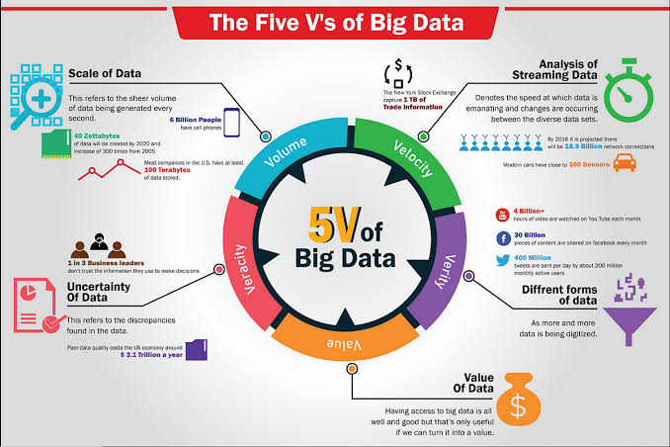
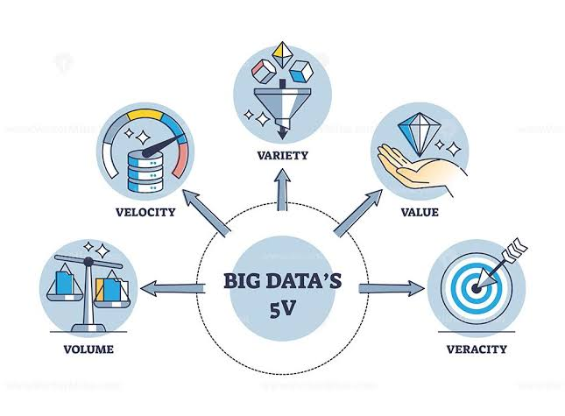
Elements of Data
What is Big Data?
Big Data refers to extremely large and complex datasets that are difficult to process and analyze using traditional data processing techniques. It encompasses both structured and unstructured data and is characterized by the five Vs: Volume, Velocity, Variety, Veracity, and Value.

Slide 6
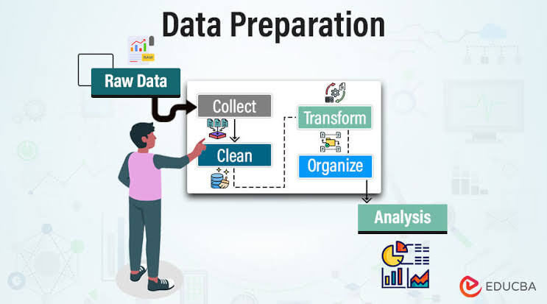
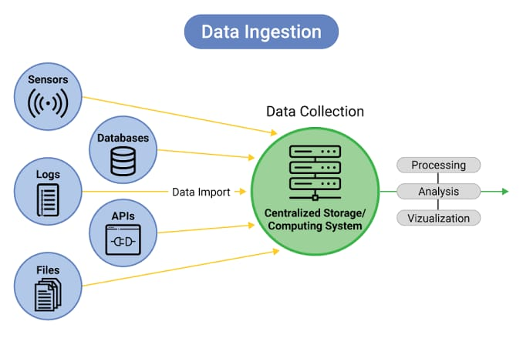
Processing of Big Data
Processing Big Data involves various techniques and tools to efficiently handle, manage, and analyze large and complex datasets. AWS provides a range of services designed to process Big Data, ensuring scalability, speed, and flexibility.
Data Ingestion & Preparing:The process of collecting data from various sources and bringing it into a central system or data repository.
The process of transforming raw data into a clean and structured format suitable for analysis.

Slide 7
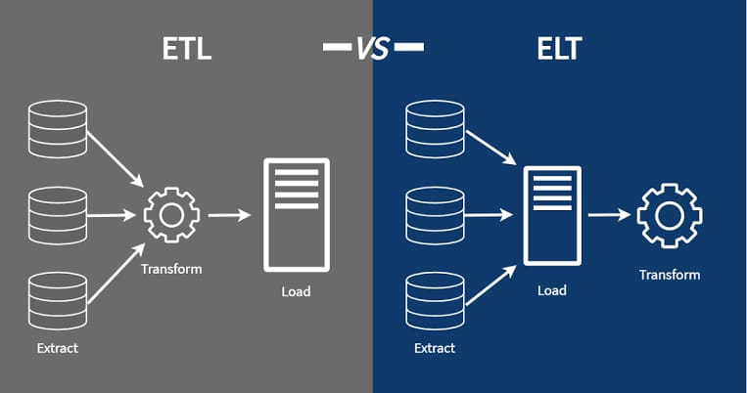
ETL And ELT
ETL (Extract, Transform, Load): ETL is a data processing method where data is first extracted from source systems, transformed into a suitable format, and then loaded into a data warehouse or data lake.
ELT (Extract, Load, Transform): ELT is a data processing method where data is first extracted from source systems, loaded into a data repository (e.g., data lake), and then transformed within the target system.

Slide 8
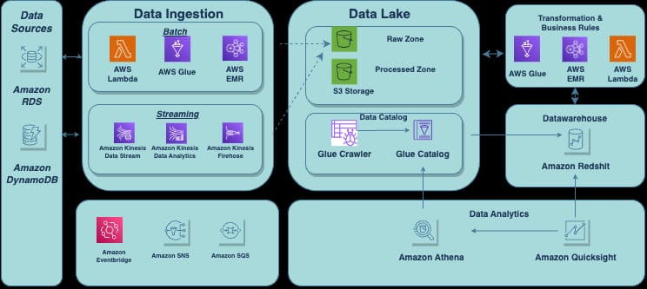
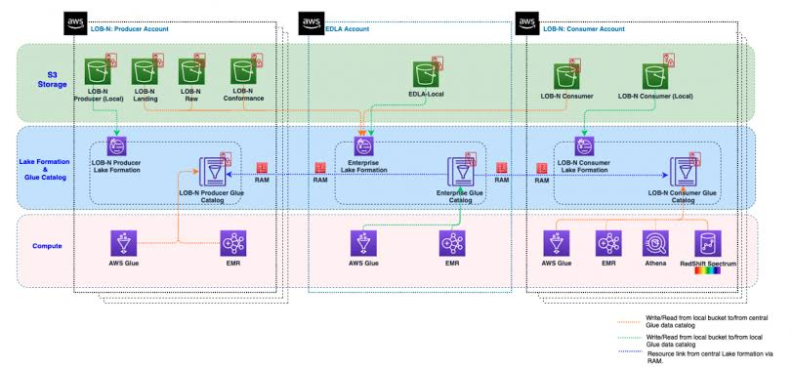
Data Storing and Organizing Data
Data Storing: The process of saving
data in a manner that allows for easy
retrieval, management, and analysis.
Effective data storage solutions balance
cost, performance, and scalability.
Data Lake: To store all your structured
and unstructured data at any scale.
Data Warehouse: Data warehouses
store data in a structured format,
often organized by schemas.

Slide 9

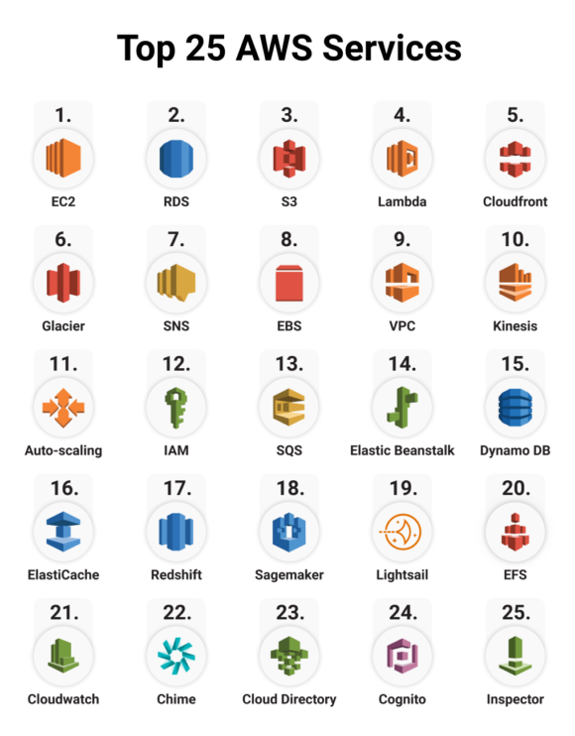
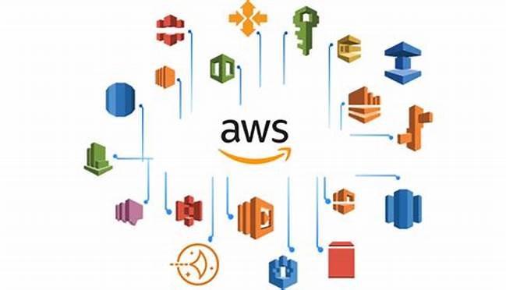
AWS Tools
AWS offers a variety of tools and services that can be useful depending on your needs
Amazon S3
Amazon EC2
Amazon RDS
Amazon Lambda
AWS Glue
AWS Code Pipeline
AWS Step Functions

Slide 10
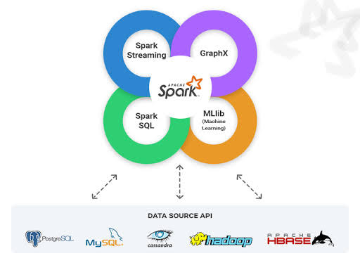
Spark
Apache Spark is a powerful open-source distributed computing system designed for processing large datasets quickly. It's known for its speed, ease of use, and sophisticated analytics capabilities, including support for SQL, streaming data, machine learning, and graph processing. Here are some key features of Spark:
Easy of Use
Flexibility
Advanced Analytics

Slide 11
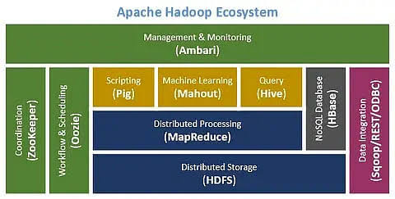

Hadoop
Apache Hadoop is another robust open-source framework for distributed storage and processing of large datasets. It is designed to scale up from a single server to thousands of machines, each offering local computation and storage. Here are the key components and features of Hadoop:

Slide 12
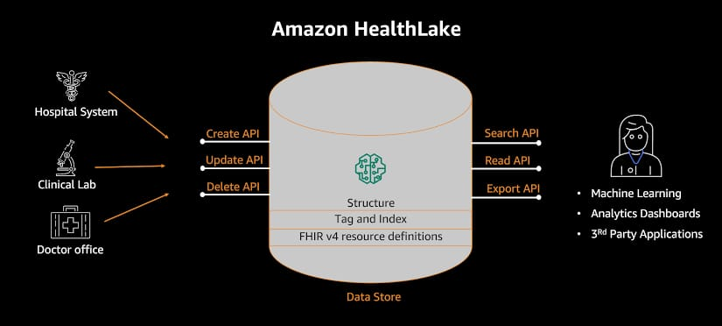
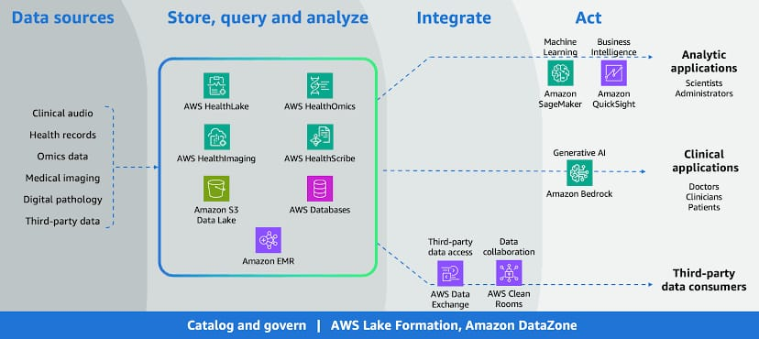
Real Time Example
Here are some real-time examples of how AWS Data Engineering is applied across different industries:
Healthcare Patient Data Integration
A healthcare provider wants to integrate and analyze patient data from multiple sources for improved care and decision-making.

Slide 13

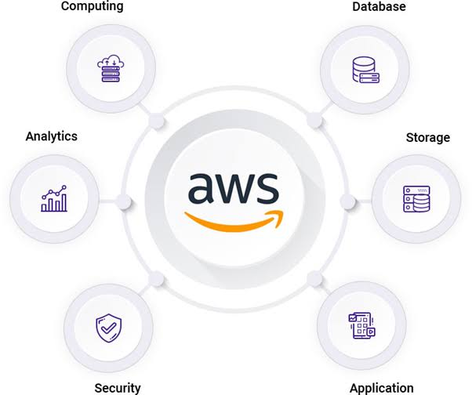

Applications
AWS data engineering services can be applied across various industries and use cases to solve complex data challenges. Here are some prominent applications:
Fraud Detection
& Financial Transactions
Healthcare
Customer Sentiment
Analysis for Social Media

Slide 14
Outcomes
By the end of the AWS Data Engineering Virtual Internship with AWS participants should have a comprehensive and immersive experience in the field of data engineering, providing hands-on exposure to various tools, technologies, and methodologies.
Data Quality and Consistency: Implementation of data validation and cleansing processes improved data quality.
In this virtual internship, you learned about the key components of AWS data engineering, including data collection, ingestion, storage, processing, transformation, and analytics.

Slide 15
Conclusion
In conclusion, AWS Data Engineering Virtual Internship I have learned a lot about how to use AWS tools to analyze process data and to identify and prioritize improvement opportunities..
The outcomes of this project were substantial. We achieved improved data processing efficiency, enhanced data storage and management, and cost savings.

Slide 16
References
Website Data Engineering with AWS - Second Edition [Book] (oreilly.com)
Website 9 Data Engineering Books : The Best Books For Data Engineers (analyticsvidhya.com)
Spark: The Definitive Guide: Big Data Processing Made Simple 1st Edition, Kindle Edition
Data Engineering with AWS: Acquire the skills to design and build AWS-based data

Slide 17
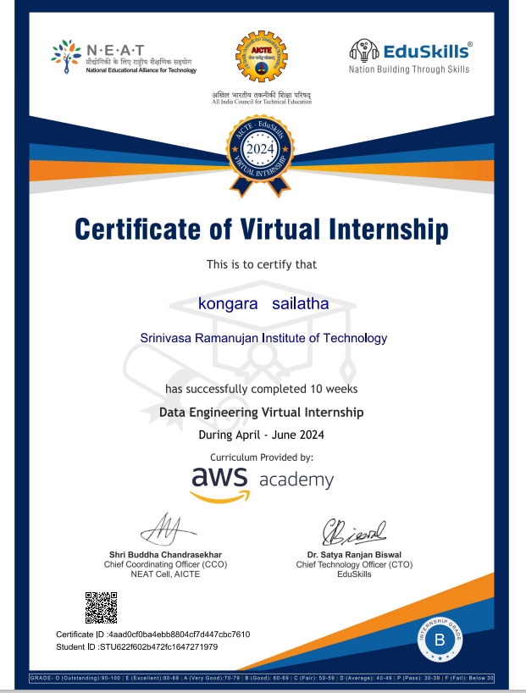
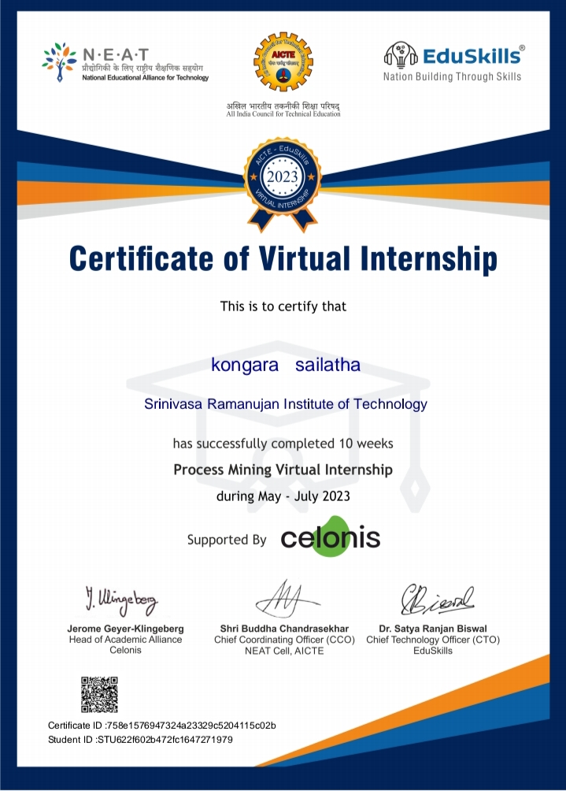
Internship certificate

Slide 18
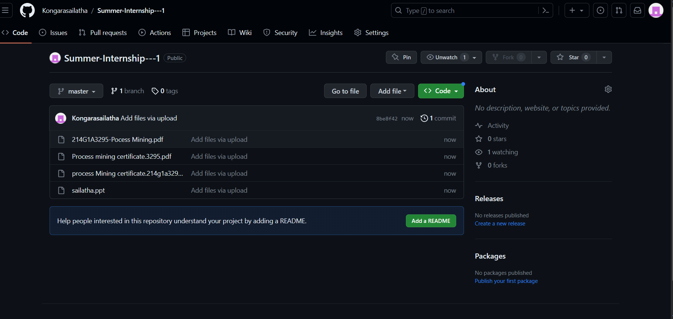
Git Hub Dashboard
Repository Name : Summer Internship - II
https://github.com/Kongarasailatha/Summer-Internship---2

Slide 19
Thank You!!!

